Slide 1
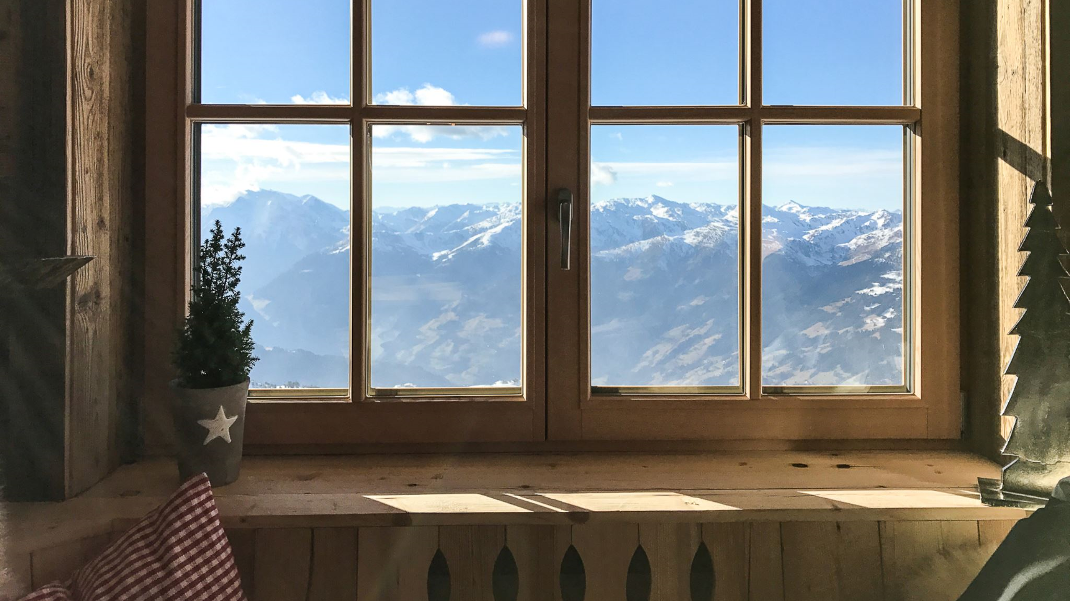
Birthrates in Swiss Districts
Understanding Demographic Trends in Switzerland
Presented by: Sujal Manandhar
Student ID: 23189654

Slide 2
Table of Content
Introduction
Motivation
Goals
Nature
Result & Insight
Decision Making
Conclusion
Data Science Life Cycle
Student ID: 23189654

Slide 3
Introduction
In 1888, Switzerland was going through a big change in how many babies were born and in its economy. This study looks at how many babies were born in different parts of Switzerland during this time. By looking at data about babies and things like jobs and religion in 182 areas, we can learn more about why people were having babies and how it affected Switzerland back then.
Student ID: 23189654

Slide 4
Motivation of the Chosen Domain
Understanding Socio-Economic Factors: The study aims to gain a deeper understanding of the socio-economic factors influencing fertility rates in Swiss districts. Insights from this analysis are crucial for effective policy-making and planning, ensuring balanced and sustainable development for the future.
1
Contributing to Demographic Discourse: This research contributes to the broader discourse on demographic trends and their implications. By examining the intricacies of fertility rates and their determinants, the study offers valuable information for researchers and policymakers, enhancing their ability to make informed decisions.
2
Student ID: 23189654

Slide 5
Goals of the Data Science Project
Analysing trends and patterns in birthrates
1
Identifying socio-economic factors associated with fertility rates
2
Building predictive models for estimating future fertility trends
3
Exploring correlations with other demographic indicators
4
Student ID: 23189654

Slide 6
Nature of the Data
Source of the data: Historical records and demographic surveys from around 1888 (search.r-project.org)
Structured
Date/Publication: 2023-09-29
Collected through systematic data gathering processes, like involving surveys & census data collection.
Student ID: 23189654

Slide 7
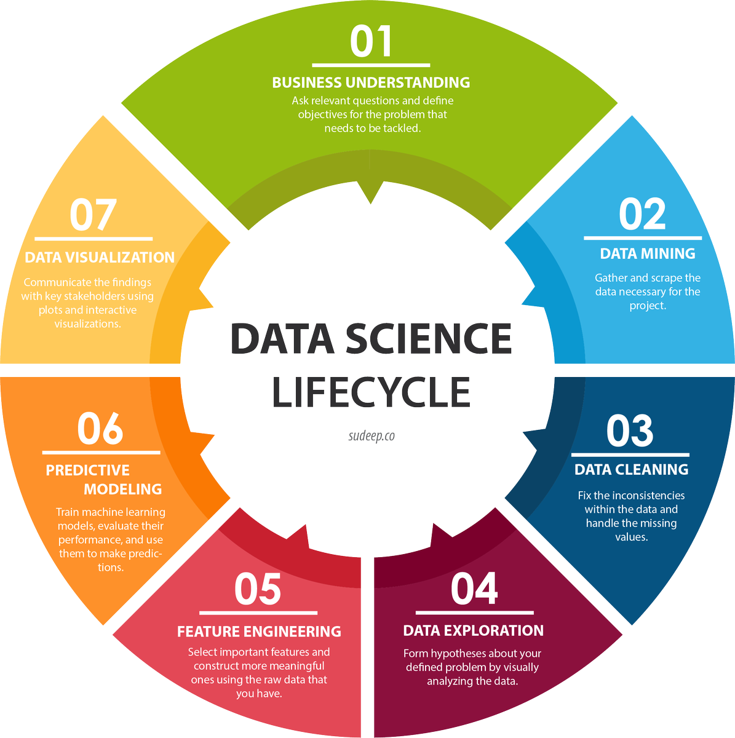
Data Science Life Cycle
Data Collection
Data Cleaning
Exploratory Data Analysis
Data Modeling
Evaluation
Data Visualization
Student ID: 23189654

Slide 8
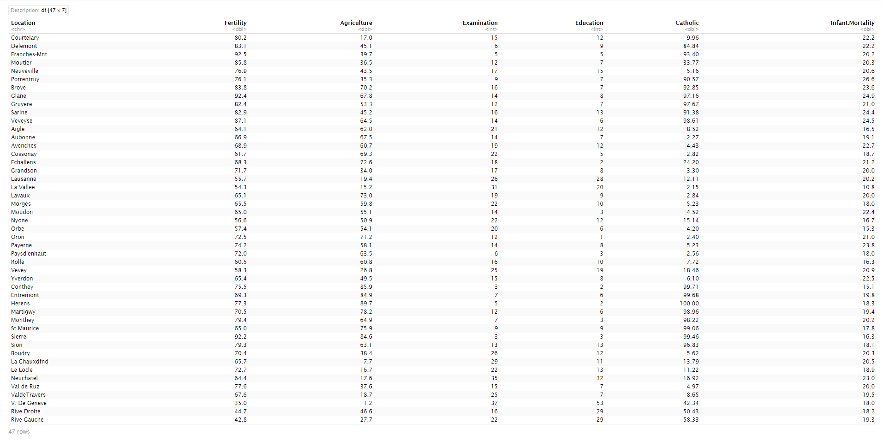
Main dataset
Student ID: 23189654

Slide 9
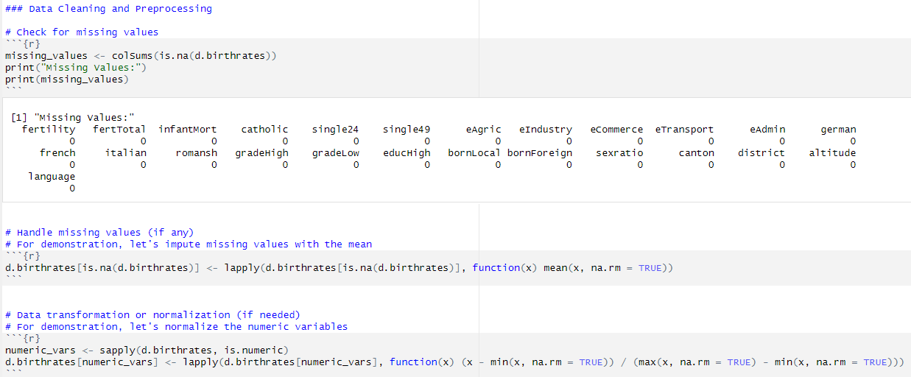
Data Cleaning
Student ID: 23189654

Slide 10
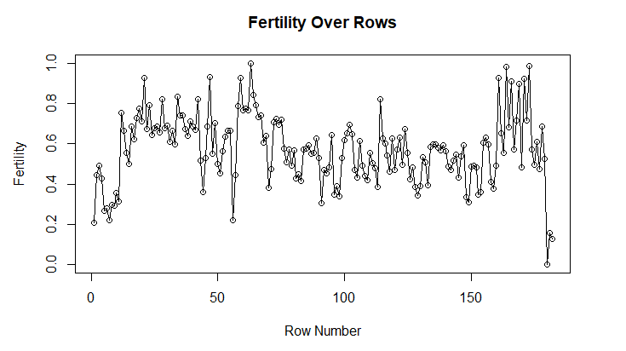
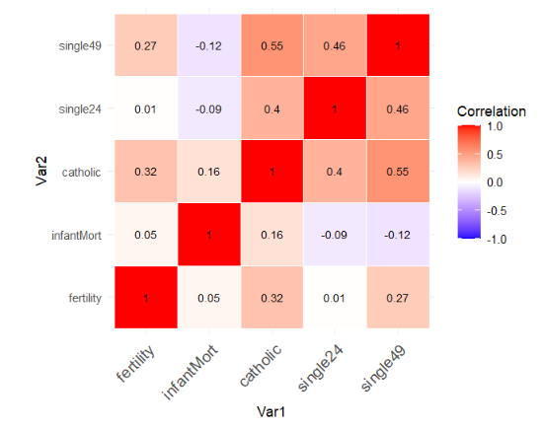
Shows the trend and variation in fertility rates across the rows of the dataset.
Exploratory Data Analysis (EDA)
Variability
Summary Statistics
Shows the trend and variation in fertility rates across the rows of the dataset.
Correlation Analysis
Visualizes the strength and direction of correlations between fertility and demographic variables.
Student ID: 23189654

Slide 11
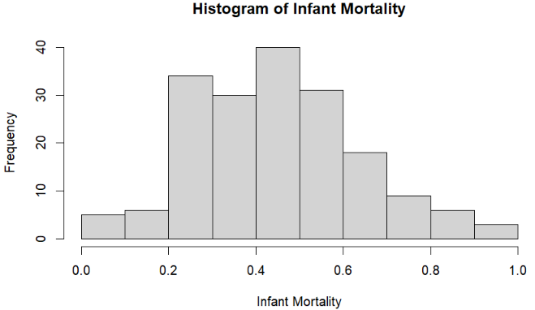
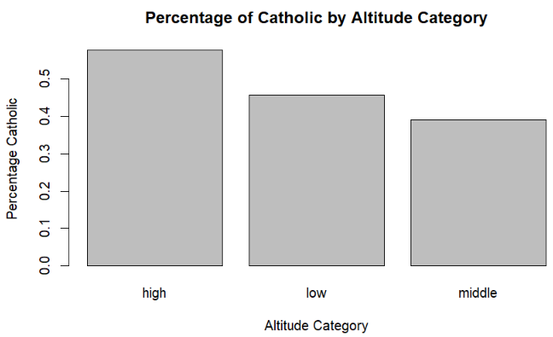
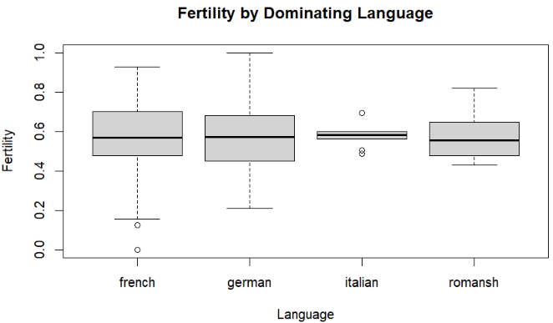
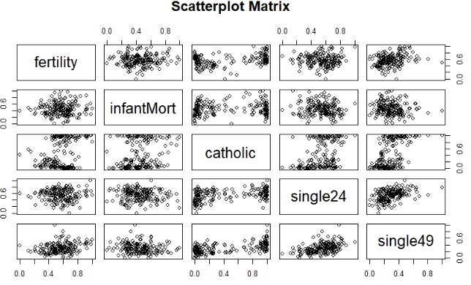
Shows the distribution of infant mortality rates across districts.
Depicts the average percentage of Catholics categorized by altitude ranges.
Visualization
Illustrates how fertility rates vary across different dominant languages spoken in districts.
Displays pairwise relationships between fertility and other variables (infant mortality, catholic percentage, single rates).
Student ID: 23189654

Slide 12
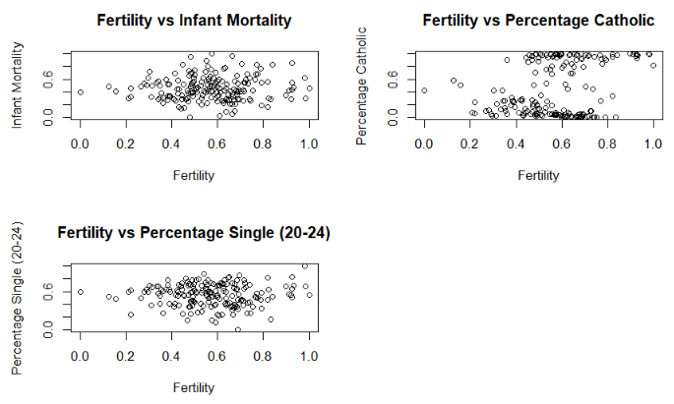
Fertility against other variables
1. Fertility vs Infant Mortality
Examines the relationship between fertility rates and infant mortality rates.
2. Fertility vs Percentage Catholic
Shows how fertility rates relate to the percentage of Catholics in districts.
3. Fertility vs Percentage Single (20-24)
Explores the relationship between fertility rates and the percentage of single individuals aged 20-24.
Student ID: 23189654

Slide 13
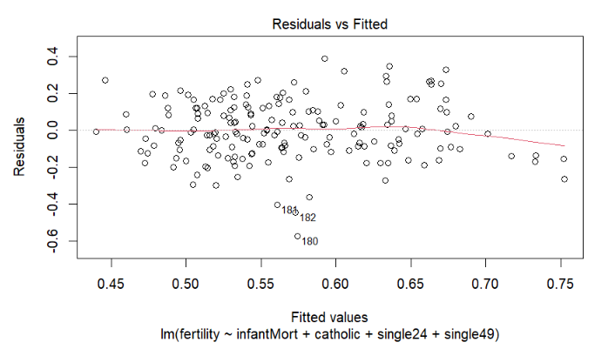
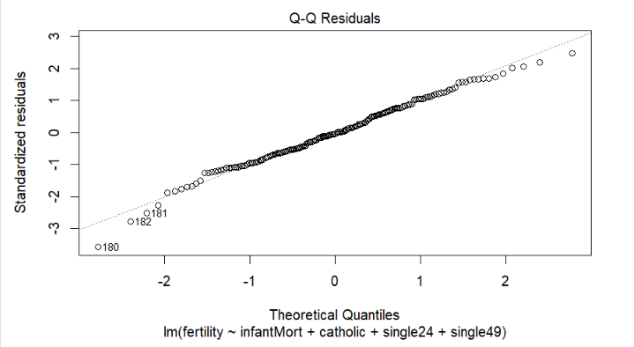
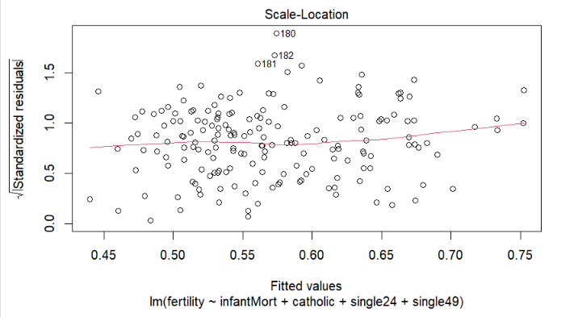
Linear Regression
1. Residuals vs Fitted
Checks for homoscedasticity (constant variance) of residuals in the linear regression model.
2. Normal Q-Q Plot
Assesses the normality assumption of residuals in the linear regression model.
3. Scale-Location Plot
Further examines homoscedasticity of residuals in the linear regression model.
Student ID: 23189654

Slide 14
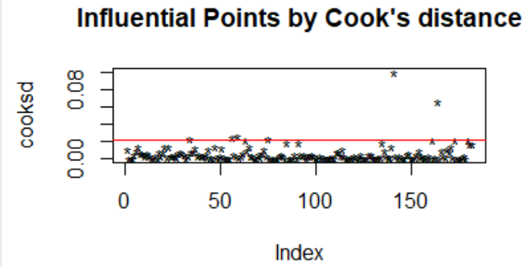
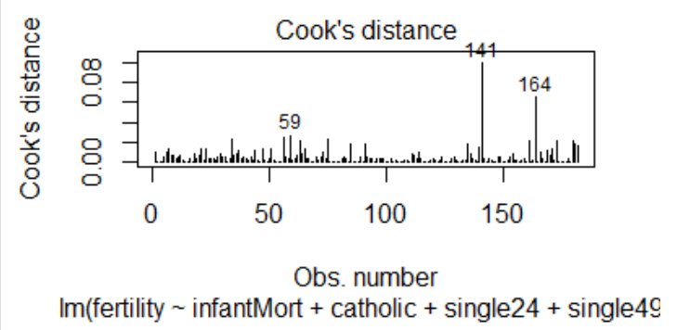
Cook’s Distance
In this code, we model fertility rates in Swiss districts using multiple predictors: infant mortality (`infantMort`), the percentage of Catholics (`catholic`), and the percentages of single women aged 24 and younger (`single24`) and 49 and younger (`single49`). The data is split into training (80%) and testing sets for model validation. A linear regression model is fitted with the formula `fertility ~ infantMort + catholic + single24 + single49`. We then print the model summary and check for influential data points using Cook's distance, highlighting those with a value above a certain threshold to identify potential outliers.
Student ID: 23189654

Slide 15
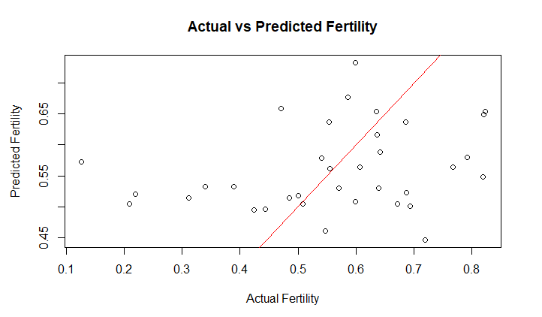
Evaluation
An MSE of 107.23 suggests that, on average, there is a substantial difference between the predicted fertility rates and the actual fertility rates in dataset. If this MSE seems unexpectedly high, it might be worth revisiting the model, checking assumptions, and possibly exploring different modeling approaches or data transformations.
Points clustered tightly around the red line indicate accurate predictions.
Points scattered away from the line suggest discrepancies between predicted and actual values.
The metric quantifies the average squared difference between predicted and actual fertility rates across the districts in your test dataset. A higher MSE indicates greater prediction variability or error, highlighting areas where the model may struggle to accurately predict fertility rates.
This visual representation not only assesses prediction accuracy but also helps identify outliers or patterns where the model might benefit from further refinement or additional explanatory variables.
Visualize Results
Student ID: 23189654

Slide 16
Results and Insights
Visualizations: Charts, graphs, and tables highlighting trends and correlations
Discussion of significant patterns and relationships uncovered
Student ID: 23189654

Slide 17
Use of Project Results for Decision Making
Explanation of how project results can inform decision-making processes
Potential applications in public policy, healthcare, and urban planning
Importance of data-driven insights in addressing societal challenges
Student ID: 23189654

Slide 18

Conclusion
Birthrates in Swiss districts vary regionally due to socio-economic factors.
Correlate with indicators like infant mortality and education.
Influenced by geography, revealing insights into Switzerland's demographic landscape.
Student ID: 23189654

Slide 19
Thank you!!!
Student ID: 23189654

Slide 20
Any Questions?
Student ID: 23189654

